Slide 1



Welcome to
Fourth Grade!
2025-2026
Mrs. Koch, Mrs. Talley,
Dr. Warren

Slide 2
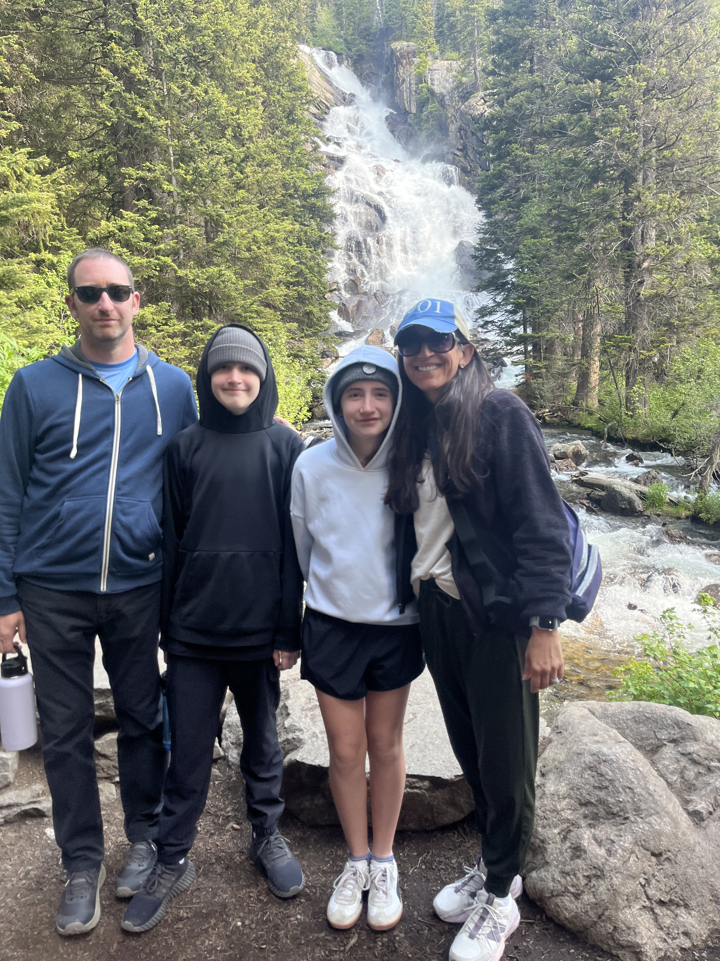
Mrs. Koch
•23 years at Richland Elementary
•Bachelor’s in Human Development
•Masters in Curriculum and Instruction
•National Board Certification-2010 and 2020
•I have a son in 7th grade and a daughter in 5th

Slide 3
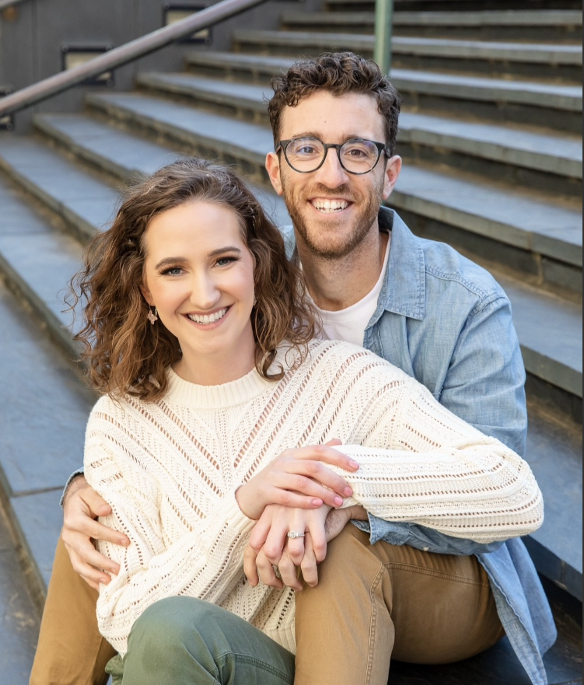
Mrs. Talley
I am starting my second year at Richland.
Alumni of University of Memphis and Western Governors University
Master of Arts in Teaching
Avid tennis player

Slide 4
Dr. Warren
This year will be my 13th year teaching.
3rd year at Richland
Attended University of Louisville and Georgia State University
My wife and I have two young daughters including a third grader at Richland.

Slide 5
Weekly Communication
Newsletters containing lessons for each subject will be posted on our websites by Friday afternoons. Each website will contain the SAME newsletter.
Newsletters can be found under “Updates” on each webpage.
You can access all teacher webpages through Richland Elementary’s homepage.
IMPERATIVE: Please ensure you have a working email address in PowerSchool. Reach out ASAP if it is not current.

Slide 6
Communication! Class DoJo
We will be using Class Dojo for quick messaging. We are currently in the process of finalizing details and adding parents to our classes.
For emergencies, please call office.

Slide 7
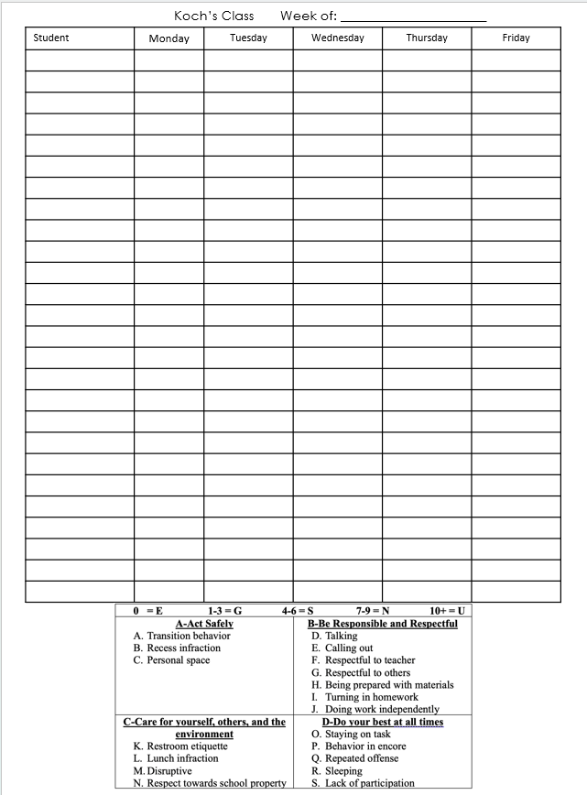
Behavior
We will follow SCS and Richland behavior guidelines.
We monitor classroom behavior daily. We use a clipboard that follows students to each class. We can then notify you if there is a behavior issue that occurs during the day.
The following chart will allow us to keep track of conduct/work habits throughout the quarter.

Slide 8
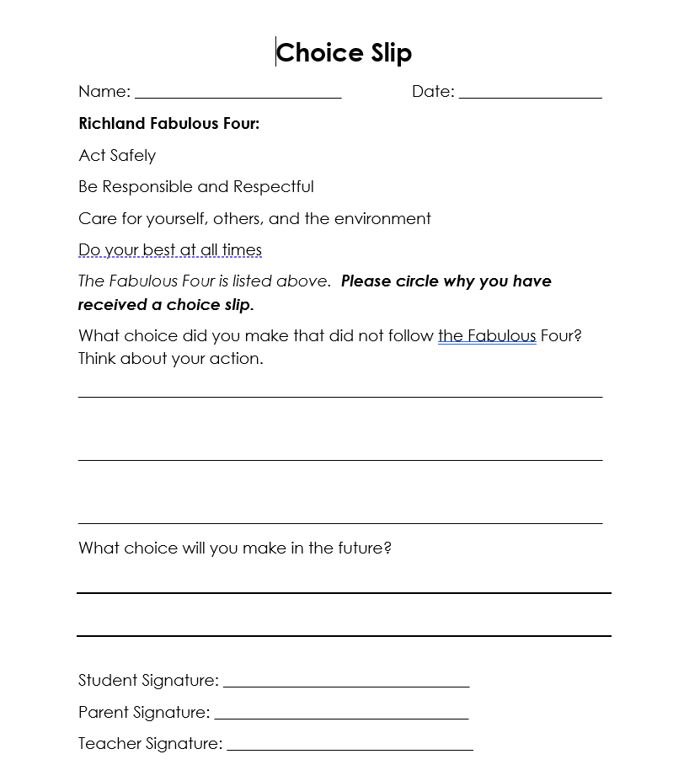
Behavior– Choice Slip
Students will always be given chances to correct behavior prior to receiving conduct marks or consequences.
If necessary, choice slips will be issued if warnings were insufficient.

Slide 9
4th grade Schedule
RECESS occurs during Science/Soc. Stud.
We will operate on an A/B schedule. See homeroom websites for specifics on schedules.
ENCORE: Varies by teacher
8:05-8:15: Good Morning (Homeroom check in)
8:15-9:00: BOOST/Intervention
9:05-10:35: Block 1
10:35-11:25: ENCORE
11:30-1:00: Block 2
1:00-1:30: LUNCH
1:35-3:00: Block 3

Slide 10
SNACKS
We have working water fountains in each hallway. Students may bring water bottles to school. Each class will have specific water bottle procedures.
Due to our late lunch, students may bring a healthy snack! (DRY)
We will not allow candy, Takis, Cheetos, items needing a spoon, or full lunch items

Slide 11
Attendance/Tardies/School Hours
School Hours: 8:15-3:15
If your child is going to be absent for several days, please let us know so that we can gather make up work. We will need ample notice to gather materials.
We will likely not have time to gather work the day of.
When your child returns to school, please send an excuse note/doctor note.
Make up work is the responsibility of the student!
Dismissal: Please pick up your child at 3:15. We often have meetings scheduled at 3:30 that we must attend.

Slide 12
Conferences
Email: If your concern is minimal, you are welcome to email at any time. We will respond within 24 hours.
kochlf@scsk12.org
talleyt@scsk12.org
warrenrb@scsk12.org
Please be mindful that emailing about an assignment at 7-8 pm may not receive a response prior to the next day.
Conferences can be held virtually or in person. We are generally available in the mornings (10:35-11:15), except Tuesdays.
Dependent upon schedules, after school meetings may take place.
If your concern is specific to reading, please contact Mrs. Talley. Likewise, if your concern is specific to science/social studies, reach out to Mr. Warren, etc.
We are happy to schedule conferences with you when you have a concern to discuss. You do not need to wait until parent-teacher conference night.

Slide 13
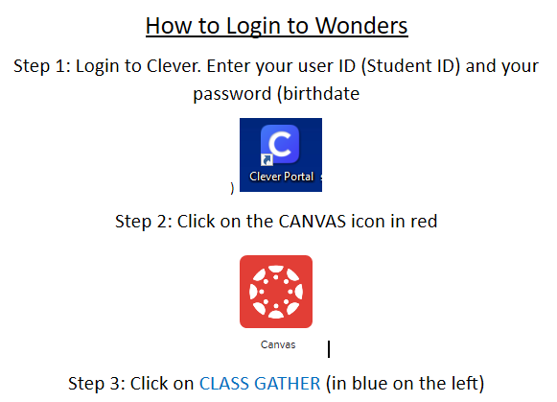

Curriculum: WONDERS
-Almost all assignments will be completed through the Wonder’s Portal. To access the text, spelling, or any extra assignments, follow the steps below to login.

Slide 14
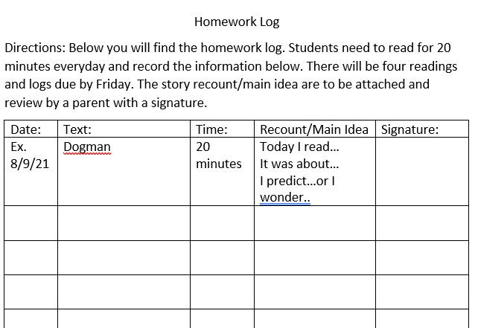
Reading Log

Slide 15
Curriculum: Envision Math
Math content will be taught based on TN State Standards. MSCS uses Envision Math as our curriculum. I will supplement as needed to ensure students meet the expectations of standards.
My approach is standards-based and data driven. I focus on concepts vs. procedures.
Study guides will be provided prior to every test! Use them!
Please be mindful of negative perceptions/attitudes surrounding math. It is most observed by children and they carry it into the classroom. Every child has enormous potential and we need to do everything to maximize it!

Slide 16
Math Facts
I give a math facts quiz every Friday. It will have 20 problems and students will have 2 minutes. We will begin with the 2x math facts, then move to the 3x facts, and so on….
Math facts will be entered as project/portfolio grades which only account for 5% of the final average.
Students with 504s/IEPs will be given time and a half as noted in the plans. (if deemed necessary!)
BASIC NECESSITY in math: EXPO marker!!! These do not last all year and we will use them EVERY.SINGLE.DAY. (Check in with your child mid-year)

Slide 17
Homework
Homework is a required category in MSCS grading policy. We must include a minimum of 4 homework grades per quarter. Homework comprises 5% of the final average.
Homework is graded for completion, not accuracy.

Slide 18
Science/Social Studies
Weekly quiz
Writing in Social Studies
Homework- will only be sent if classwork is unfinished or student has makeup work.
Research!

Slide 19
MSCS Grading Policy
Homework: 5% (minimum four grades)
Class Participation: 5% (minimum four grades)
Classwork: 40% (minimum four grades)
Projects, portfolios, or presentations: 5% (minimum one grade)
Tests: 45% (minimum four grades)
10 point grading scale

Slide 20
Viewing Grades
PowerSchool is available to all parents. This is the BEST way to monitor student grades. We try to update PS often.
Wednesday folders will also contain graded papers. Please check your child’s Wednesday folder and review graded work. SIGN that you have reviewed the work. We need all work that is below a 70 to be signed and returned. Keep everything else, please!
PLEASE make sure your email addresses are correct in PowerSchool. We send updates via email.

Slide 21
TCAP
4th grade scores are important! While students will not face retention based on reading scores like 3rd grade, our scores are used to determine eligibility for middle school optional programs.
Students who are participating in yearlong tutoring due to 3rd grade retention law must show adequate growth or face possibility of retention.

Slide 22
After School Tutoring
After school tutoring should be offered in reading and math for those students who are in the most need. This will be determined based on academic performance.
Dependent on spaces available, admin will select which students qualify for tutoring.
More details will follow once tutoring teachers have been selected and schedules solidified.

Slide 23
Birthdays
Healthy Foods Policy prohibits that we disperse treats. We are NOT allowed to pass out cookies, cupcakes, candy, etc. for student birthdays.
Invites: If your child is having a birthday party, please send out invites privately and/or electronically. If invites are sent to school to be dispersed, everyone must be invited.

Slide 24
4th grade Field Trip to Discovery
4th grade students go to Discovery Park of America in Union, TN in May! We encourage anyone to chaperone (no limit). However, ALL CHAPERONES must undergo a level 3 background check. This requires fingerprinting at the board.
This trip is a bit pricey, so plan ahead! (about $70)
We take a charter bus, not a school bus, which makes it more expensive.
It is encouraged to go ahead and start the level 3 background check process early! It does take some time to get approved!

Slide 25
Notes from Mrs. Beckwith*
The cove on the other side of the teacher parking lot is not a part of the school parking lot or an "overflow" lot. There are actual residents living here that are not associated with the school in any way.
Please be mindful of that when you park there and do NOT park past the cones.
Don't park OVER or ON the cones. Having them helps keep everyone safe.
Please do NOT park in the middle of the cove. It blocks residents in their driveway, and they may need to get out quickly. (go to work, emergency, pick up kids, etc.)
Let's all keep our neighborhood clean. Even if you didn't drop it, let's pick it up.

Slide 26
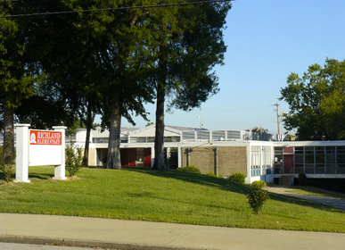
Contact
Laura Koch
kochlf@scsk12.org
Taylor Talley
talleyt@scsk12.org
Ryan Warren
warrenrb@scsk12.org

Slide 27

Questions??

